Slide 1
ESCAPE PLAN

Slide 2
DESIGNED BY :
154402(Imam Mosharaf)
154408(Hemal Naimur)

Slide 3
Our Target
To make BANGLADESH acquainted in the world of tourism
To meet the need of global visitors including our own people
To discover unknown attractive places throughout the country
To meet the taste, necessity & demand of people

Slide 4
INITIALIZATION
At the very beginning user will log in through their respective user id as well as password .
If the user id & password is correct he will be able to access our program.
Else a message will be shown to retry.
In our program we have initialized only 3 users with their respective passwords –
*user1 : id. aa pass. aa
*user2: id. bb pass. bb
*user3: id. cc pass. cc
With the usage of our program our users list will be enriched (we hope so) gradually.

Slide 5
Features
Visiting places
Rate places
Add places
Feedback
Help
About us
Exit

Slide 6
VISITING PLACES
GENERAL CATEGORY
RATING-WISE
SEARCH YOUR DESIRE
CUSTOMIZED
BACK
HOME

Slide 7
GENERAL CATEGORY
Historical
Natural
Beach
Architectural
Religious
Regional
Waterfall
Eco tourism
Back
Home
Notes:
After this user will choose any of the above options. Then the contents will be shown as per the direction. Let us assume that user chose natural beauties.

Slide 8
NATURAL BEAUTIES
Saint Martins
Jaflong
Bichanakandi
Ramsagor dighi
Garo hills
Notes:
There is a text file (“Visiting Places.txt”) from where all these places are searched and sorted out according to the choices of the users and finally shown to the screen.

Slide 9
SAINT MARTINS
St. Martin's Island(name)
Northeastern of the Bay of Bengal, Cox's Bazar(location)
Chittagong(division)
Natural(category)
St. Martin's Island is a small island in the northeastern part of the Bay of Bengal, about 9 km south of the tip of the Cox's Bazar-Teknaf peninsula, and forming the southern most part of Bangladesh …(description)
https://en.wikipedia.org/wiki/St._Martin%27s_Island(for more details)
Notes:
There will an option for the user to show image of the place. If they are willing to watch the image the image will be shown in image viewer(pressing ‘y’ ). Else the program will return to it’s initial page.

Slide 10

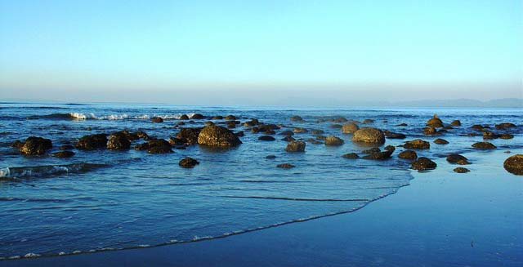

…

Slide 11
Features within VISITING PLACES
RATING WISE
- here users will be able to find out places as per the ratings.
SEARCH YOUR DESIRE
- here users will be able to find out the places as per the name of the places.
CUSTOMIZED
BACK
HOME
Notes:
There are many limitations in our program viz-when user will search for a place if he doesn’t enter the exact name as saved in the text file(“Visiting Places.txt”) error will be shown. We couldn’t complete it due to some inexplicable problems and due to shortage of time.

Slide 12
Features
Visiting places
Rate places
Add places
Feedback
Help
About us

Slide 13
RATE PLACES
Users will enter their choices & they will be able to rate the places if they haven’t rated the place before.
While rating we will check whether the same user has rated the same place before. We will access this from the text file (“userx.txt”) created for each user.
If he has already rated the same place before we will notify him.
Notes:
We haven’t added any option to go back from this feature and while the rating has been done once the program goes to the very initial page. Hope you will overlook our limitations.

Slide 14
ADD PLACES
Name of the place
Where is it?
Category
Your rating on it
About the place
Notes:
The details given by the user will be saved in a file(viz-”user’s contribution.txt”). Later on the admins will verify the provided info and will take necessary steps whether to add or not.

Slide 15
Features
Visiting places
Rate places
Add places
Feedback
Help
About us

Slide 16
FEEDBACK
Help us to improve this app
The feedback will only be applicable for the admins & it will be provided by the users on the basis of their consent.

Slide 17
ABOUT US
This project was developed by
Md. Naimur Rahman Hemal (154408)
Imam Mosharaf (154402)
Special thanks to:
Fahim Shahriar Shakkhor (154440)
Shahed Ahmed ()
Mezbaur Rahman Uschas (154401)

Slide 18
thank you sir for being with us
and
for supporting us
in all steps.
Notes:
Sir please overlook our limitations. We tried our best to make the project a success.
Hope u will appreciate us.
Again we express our heartiest obligation to you.

